Slide 1
S
SEYMOUR LIBRARY
Annual Report
2023–2025
A Report to the Board of Trustees, Municipal Stakeholders, and Community Leaders

Slide 2
EXECUTIVE SUMMARY
A Community Turning to Its Library — In Every Way
The Library's core services grew steadily from 2023 to 2025 — building visits and circulation both up more than 15% — alongside strong growth in space use and digital engagement.
+15.7%
+15.4%
ALSO GROWING
+158%
Meeting Rooms
+68%
Study Rooms
Building Visits
Circulation
+167%
Website Views
65,813 → 76,167
153,970 → 177,656
Board Message
Seymour Library continues to serve its community as a trusted lending library while steadily expanding as a place residents come to meet, study, connect, and learn.
SEYMOUR LIBRARY | ANNUAL REPORT 2023–2025
2

Slide 3
BUILDING USAGE
Building Visits & Circulation, 2023–2025
Takeaway
Both collection use and physical use are increasing — residents are borrowing more and visiting more.
Building visits rose 15.7% while circulation rose 15.4%, a closely matched pace of growth.
2024 delivered the strongest single-year gains in both metrics.
SEYMOUR LIBRARY | ANNUAL REPORT 2023–2025
3

Slide 4
COMMUNITY SPACE DEMAND
Meeting & Study Room Usage
+158%
+68%
Meeting Rooms
Study Rooms
289 → 746
609 → 1,025
Meeting and study room use has grown steadily alongside the Library's core services.
SEYMOUR LIBRARY | ANNUAL REPORT 2023–2025
4

Slide 5
PROGRAMMING
Program Attendance by Audience
Key Takeaway
Combined programming (family/multi-audience) is a rapidly growing service area, up more than sevenfold — from 470 attendees in 2023 to 3,538 in 2025.
Children's programs remain the largest single audience every year.
Adult attendance has declined the most sharply, from 4,082 to 978.
Teen attendance has stayed relatively stable across all three years.
SEYMOUR LIBRARY | ANNUAL REPORT 2023–2025
5

Slide 6
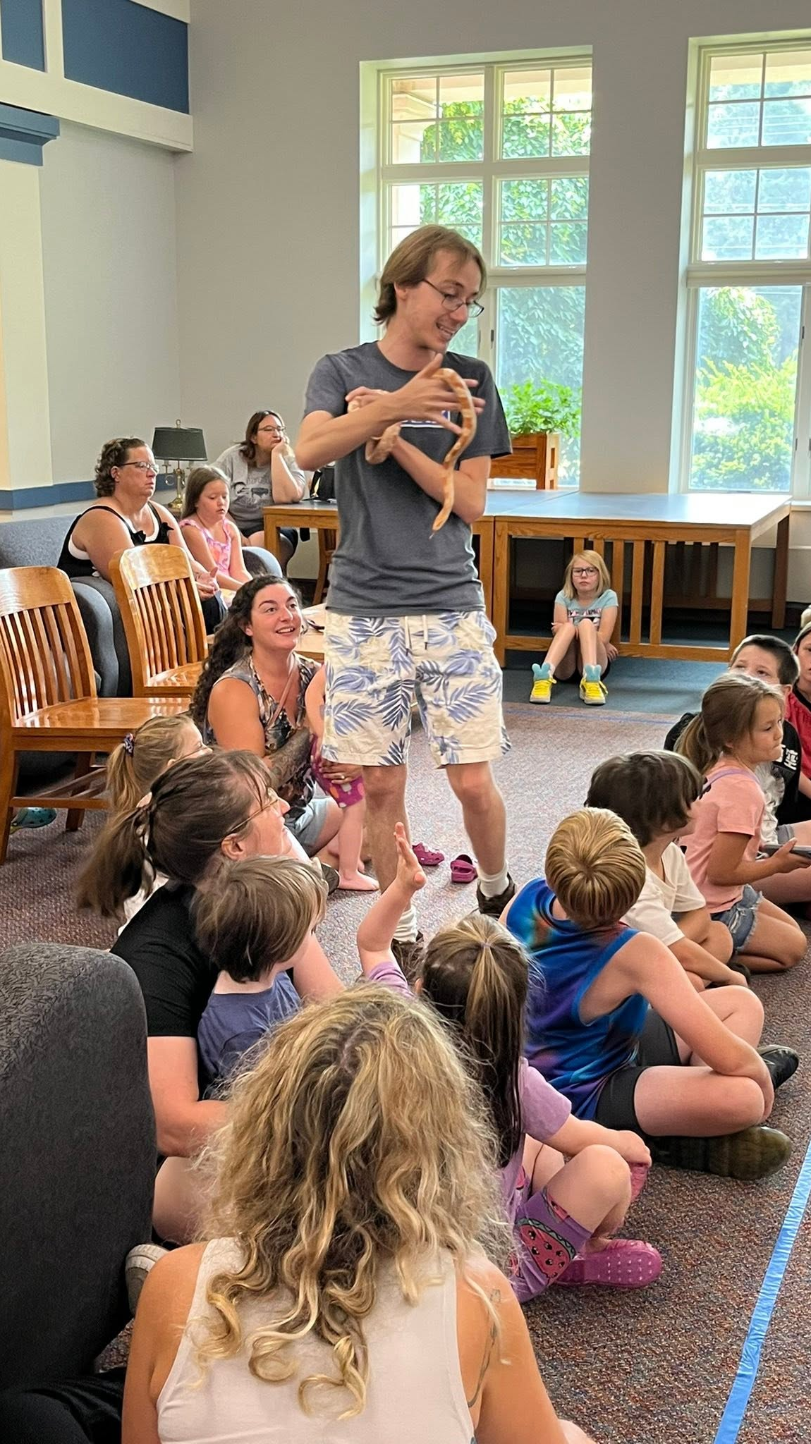
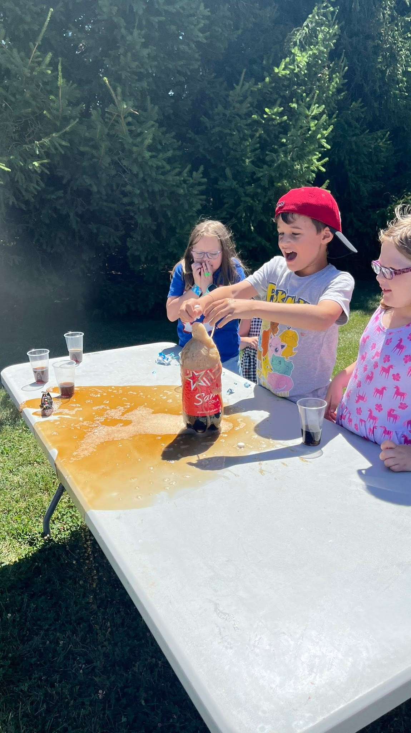
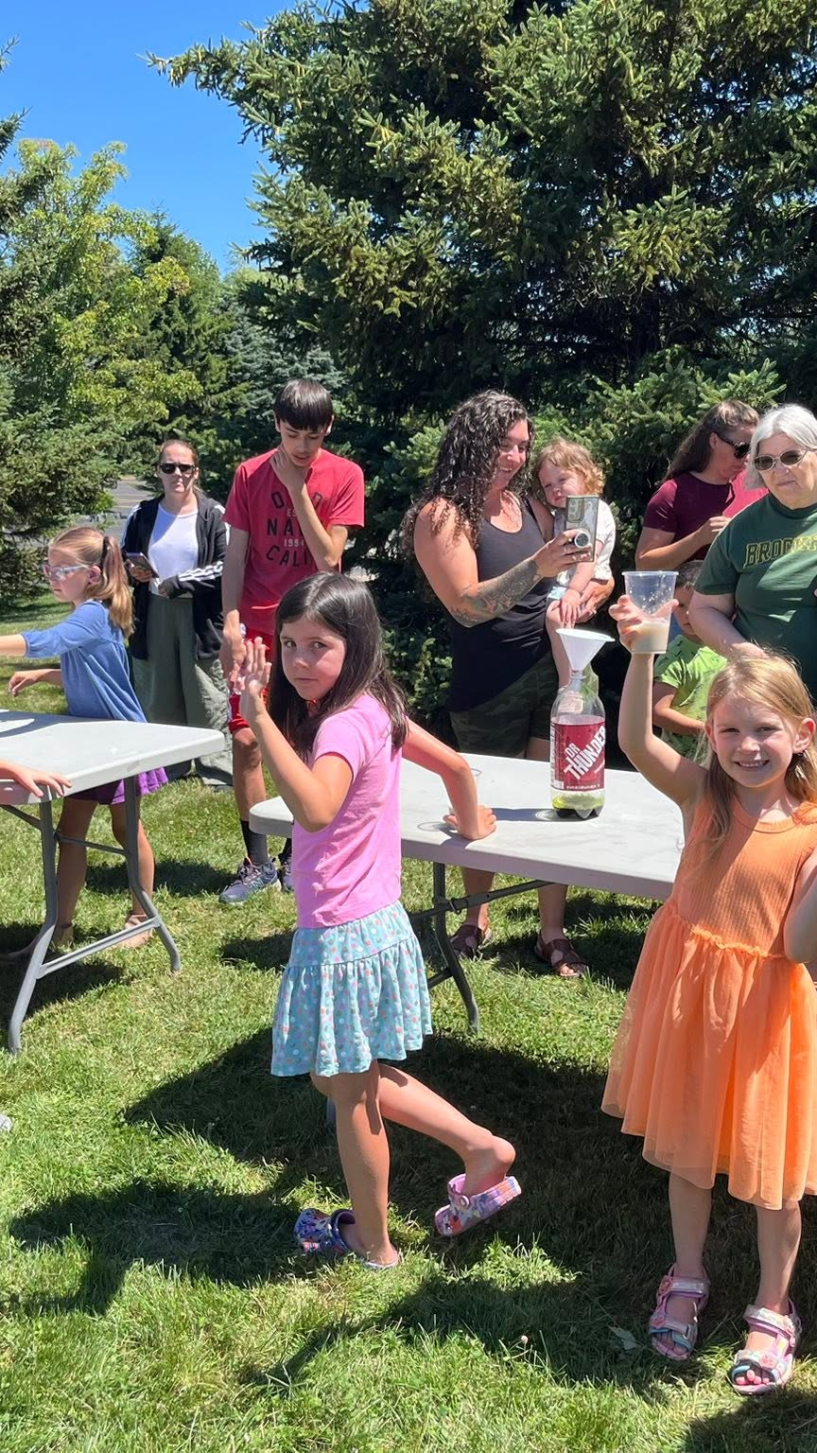
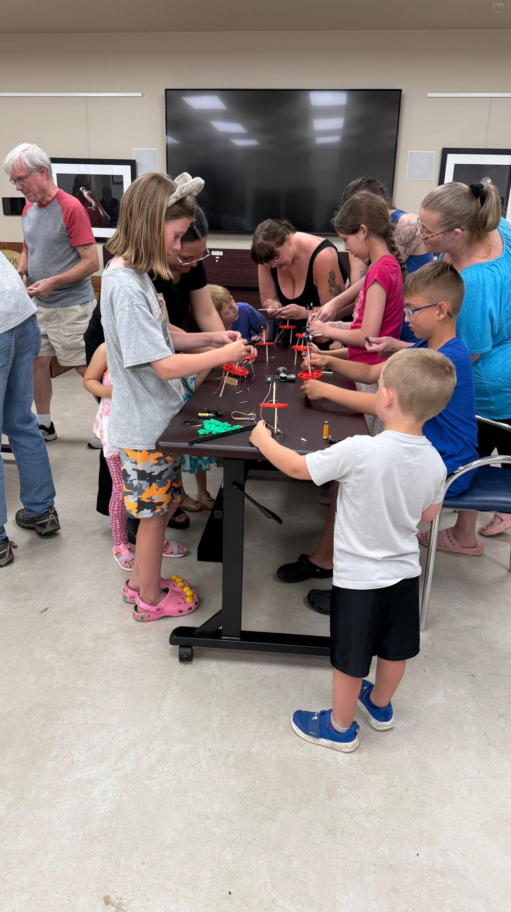
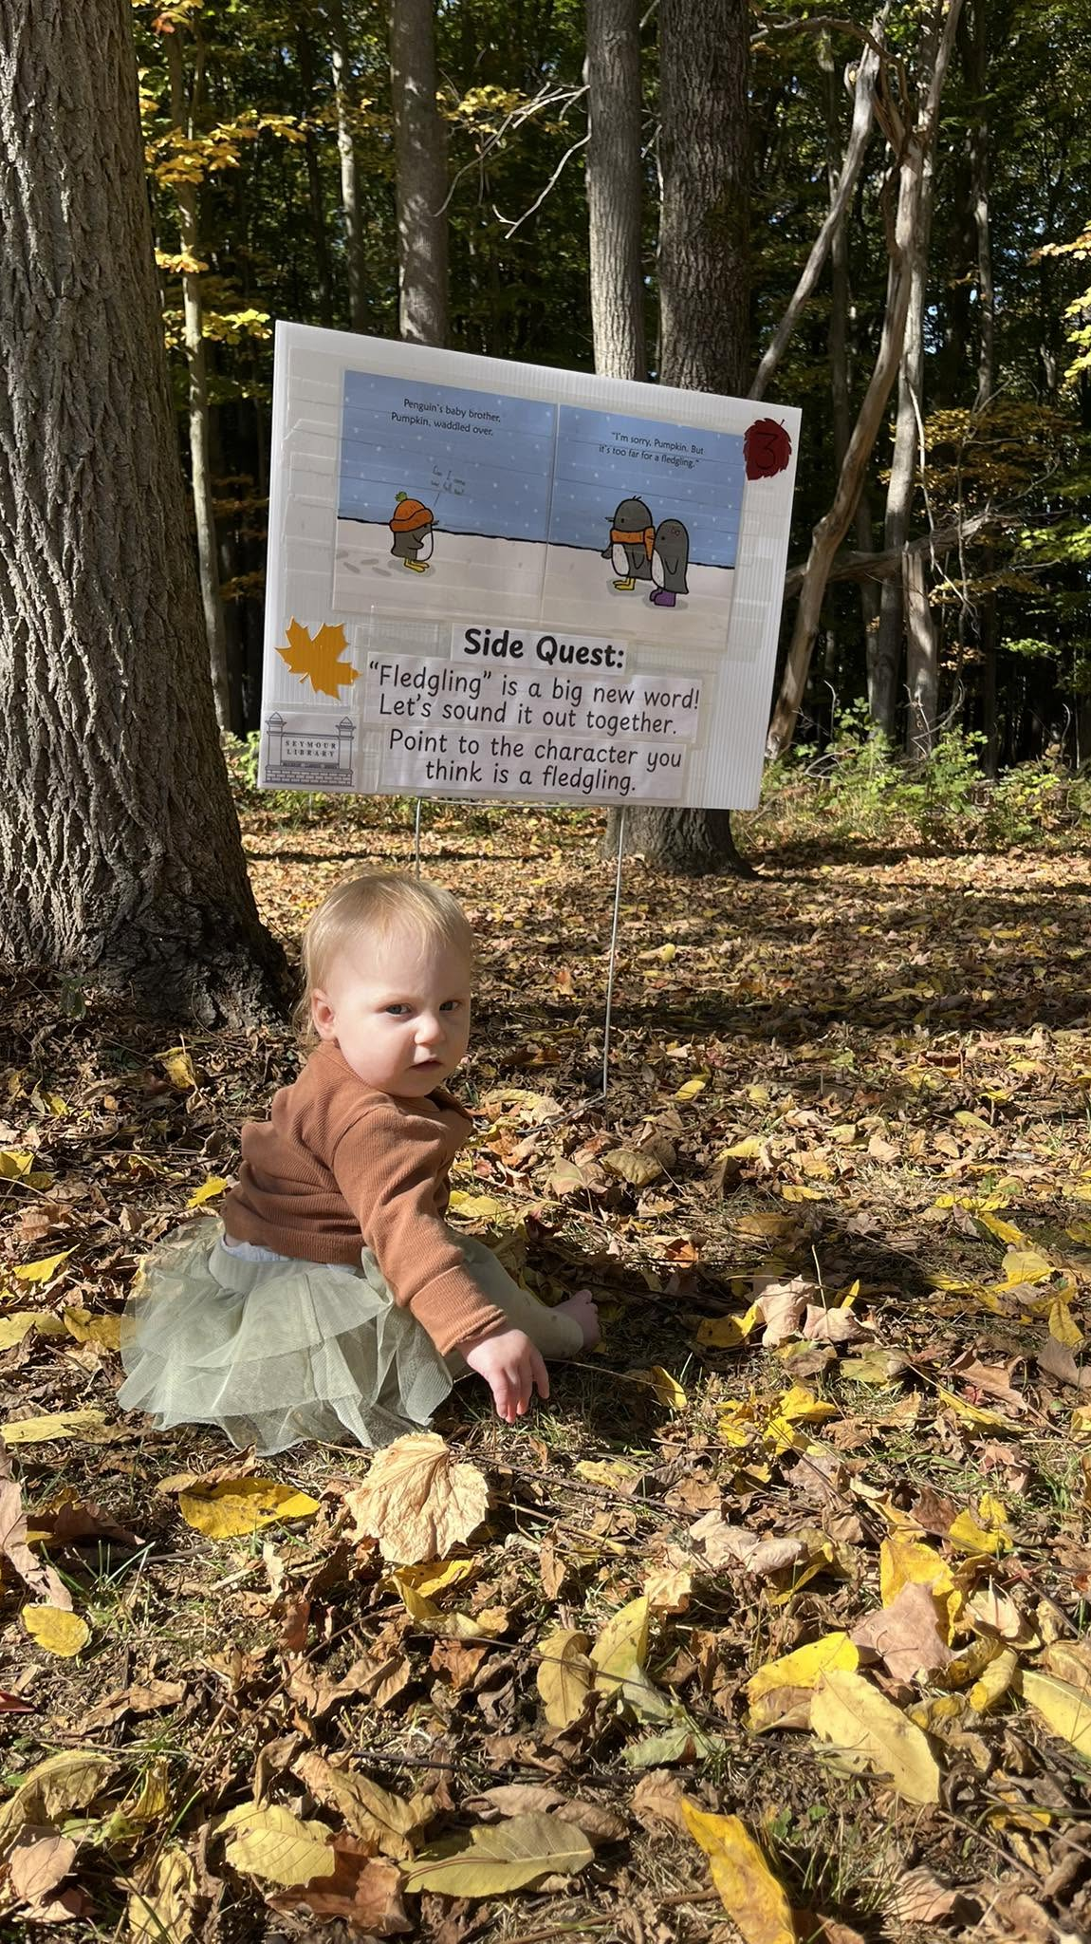
PROGRAMMING GALLERY
Learning & Discovery
Hands-on science, nature, and literacy programming across all ages.
Wildlife Encounter
Science Experiment
Community Turnout
STEM Building Club
Story Walk® in the Woods
SEYMOUR LIBRARY | ANNUAL REPORT 2023–2025
6

Slide 7
FINANCIAL OVERVIEW
Revenue Sources, 2023–2025
$925,293
Highlight
The O'Toole Estate Bequest lifted Donations & Bequests from $18,853 in 2024 to $284,925 in 2025.
That single gift drove total 2025 revenue to $925,293 — well above the 2023–2024 run rate of roughly $595,000.
Municipal support remained the steady base of revenue in every year.
Figures verified against the audited monthly financial reports for 2023–2025.
$595,574
$593,937
TOTAL REVENUE BY YEAR
SEYMOUR LIBRARY | ANNUAL REPORT 2023–2025
7

Slide 8
FINANCIAL OVERVIEW
Expense Allocation, 2023–2025
Callout
Personnel remains the Library's largest strategic investment in every year, growing from $374,352 to $477,632.
Capital Projects spiked in 2024 ($234,734) for restroom and flooring renovations, then dropped sharply in 2025.
Contractual operations costs held roughly steady across the period.
SEYMOUR LIBRARY | ANNUAL REPORT 2023–2025
8

Slide 9
FINANCIAL OVERVIEW
Where Every Dollar Goes — 2025 Expenses
67%
18%
14%
1%
Payroll & Benefits
Contractual Operations
Other Services
Capital Projects
SEYMOUR LIBRARY | ANNUAL REPORT 2023–2025
9

Slide 10
FINANCIAL OVERVIEW
One-Time Financial Drivers
2023
2024
2025
23
24
25
Dorcas Michaels
Painting Project
Restroom Renovation,
Flooring & Painting Completion
O'Toole Estate
Bequest
$82,100
$234,734
$226,406
Net Income: ($77,182)
Net Income: ($272,529)
Net Income: $208,885
Restroom $188,295 · Flooring $14,795 · Painting (cont.) $31,643
Each year's bottom-line result has been shaped by major, non-recurring items — two years of capital investment followed by one transformational gift.
SEYMOUR LIBRARY | ANNUAL REPORT 2023–2025
10

Slide 11
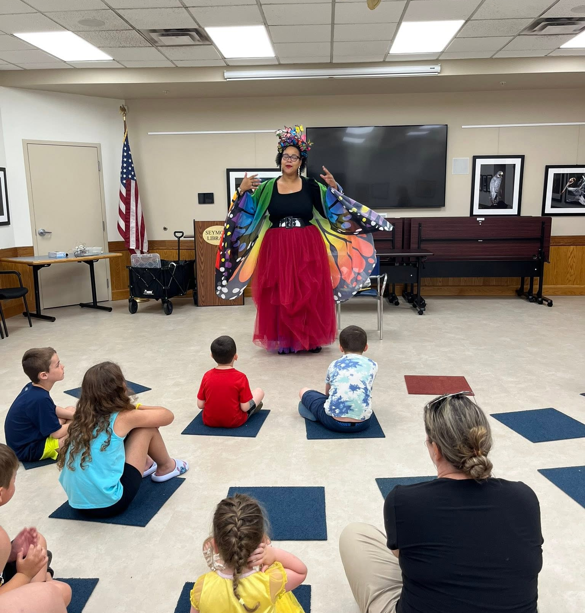
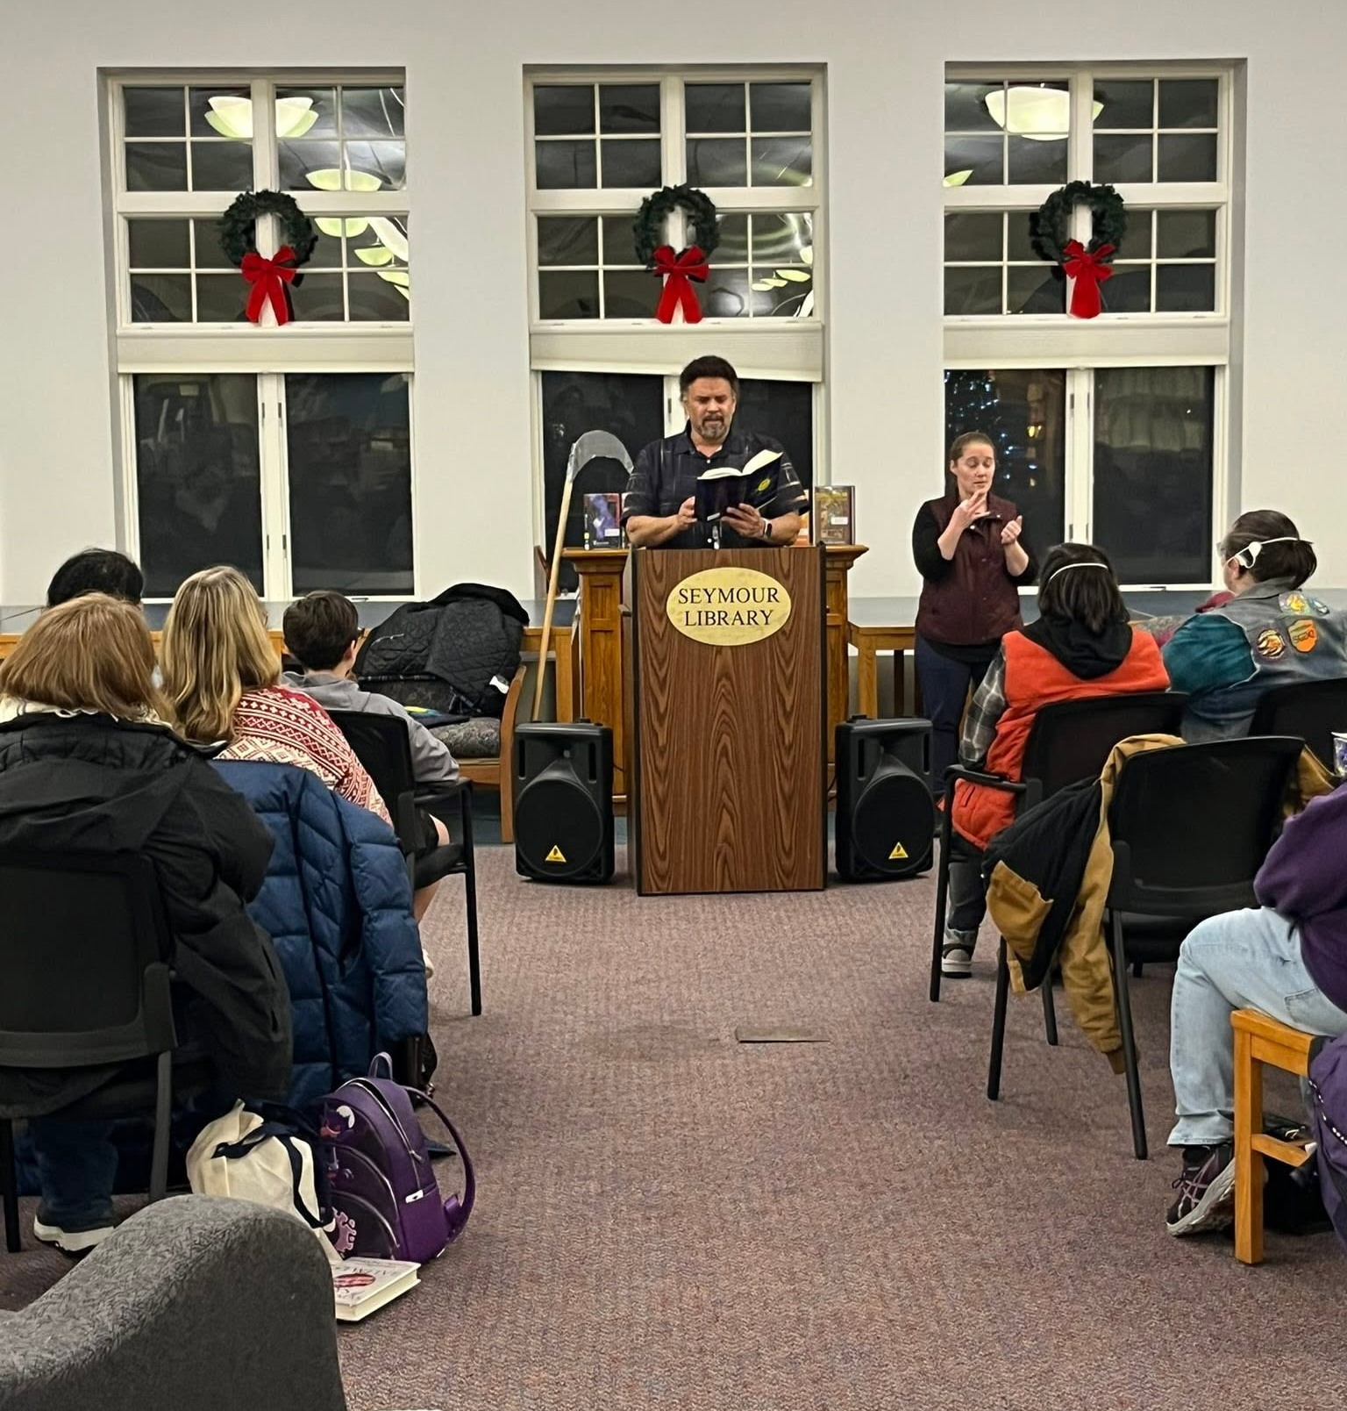
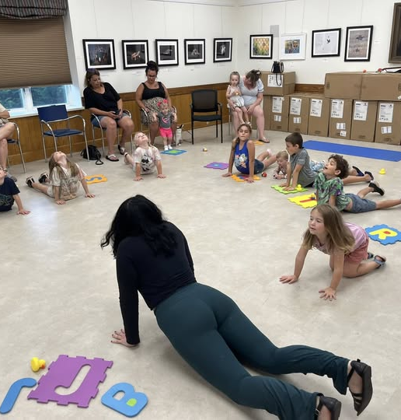
PROGRAMMING GALLERY
Stories & Performances
Storytelling, author visits, and early-literacy movement programs.
Costume Storytime
Neal Shusterman Author Visit
Toddler Movement & Storytime
SEYMOUR LIBRARY | ANNUAL REPORT 2023–2025
11

Slide 12
DIRECTOR ASSESSMENT
Library Scorecard
Cash Position
Cash fell 28% in 2024 ($409,177, capital-project year), then rose to $611,308 in 2025 — above the 2023 level.
Building Use
Visits up 15.7%; average daily traffic also increased.
Circulation
Total circulation up 15.4%, in both print and digital formats.
Programming
Combined (family/multi-audience) programming surged; standalone adult programming is the area most in need of growth.
Revenue Stability
2025 revenue growth was driven by a one-time bequest, not recurring sources.
Fund Balance
CD/reserve holdings grew from $400,000 (2023) to $550,118 (2025), +37.5%, despite a 2024 dip.
Operating Margin
Adjusted results: +$13,102 (2023), ($22,850) (2024), +$23,415 (2025) — roughly breakeven overall.
Capital Investments
Major facility reinvestment (painting, restrooms, flooring) completed 2023–2024.
Community Support
The O'Toole Estate Bequest reflects strong philanthropic trust in the Library.
SEYMOUR LIBRARY | ANNUAL REPORT 2023–2025
12

Slide 13
FINANCIAL OVERVIEW
Financial Health at a Glance
2023
2024
2025
Revenue
$595,574
$593,937
$925,293
Expenses
$672,756
$866,466
$716,408
Net Income
($77,182)
($272,529)
$208,885
Cash (year-end)
$565,519
$409,177
$611,308
Fund Balance (CDs)
$400,000
$317,094
$550,118
Expenses spiked in 2024 due to capital projects, drawing down cash and CD reserves. 2025's swing to surplus reflects the O'Toole Estate Bequest — cash and reserves both ended the year above their 2023 levels.
SEYMOUR LIBRARY | ANNUAL REPORT 2023–2025
13

Slide 14
FINANCIAL OVERVIEW
Operating Results vs. Reported Results
YEAR
REPORTED
ADJUSTMENT
ADJUSTED RESULT
2023
($77,182)
+$90,283 (capital, donation purchases, tech-grant draw)
$13,102
2024
($272,529)
+$249,679 (capital, donation purchases, tech-grant draw)
($22,850)
2025
$208,885
($185,470) net (above items, less O'Toole Bequest)
$23,415
Adjustment removes capital-project spending, reserve-funded donation purchases, and legacy tech-grant draws in every year, and (2025 only) the O'Toole Estate Bequest — the same methodology the preparer used for the 2024 operating schedule, applied consistently across all three years.
Core operations ran close to break-even across the three years — modestly positive in 2023 and 2025, with a real dip in 2024 tied to the restroom and flooring renovation.
FINDING
SUPPORTING DATA
BOARD IMPLICATION
Reported net income swings from a deficit to a large surplus across three years.
Adjusted for one-time capital and gift items: +$13,102 (2023), ($22,850) (2024), +$23,415 (2025).
Underlying, recurring operations are close to break-even — the Board should budget based on adjusted results, not headline net income.
SEYMOUR LIBRARY | ANNUAL REPORT 2023–2025
14

Slide 15
FINANCIAL OVERVIEW
Revenue Composition: A Shifting Mix
2023
2025
Municipal Support ● Donations & Bequests ● Other Sources (Friends, Grants, Misc.)
Municipal support fell from ~90% of revenue in 2023 to ~60% in 2025 — not because municipal funding declined, but because the O'Toole Estate Bequest introduced a large, extraordinary revenue source. The Library remains structurally dependent on municipal support for recurring operations.
SEYMOUR LIBRARY | ANNUAL REPORT 2023–2025
15

Slide 16
STAFFING INVESTMENT
People Power Public Service
55.7%
48.3%
of 2023 Expenses
of 2024 Expenses
Libraries are a service, not a product — staff expertise IS the product.
66.7%
of 2025 Expenses
Staffing is the largest investment category for nearly every public library. Programming, reference service, circulation, and building operations are all labor-intensive, human-delivered services — the payroll line is where community impact is produced.
SEYMOUR LIBRARY | ANNUAL REPORT 2023–2025
16

Slide 17
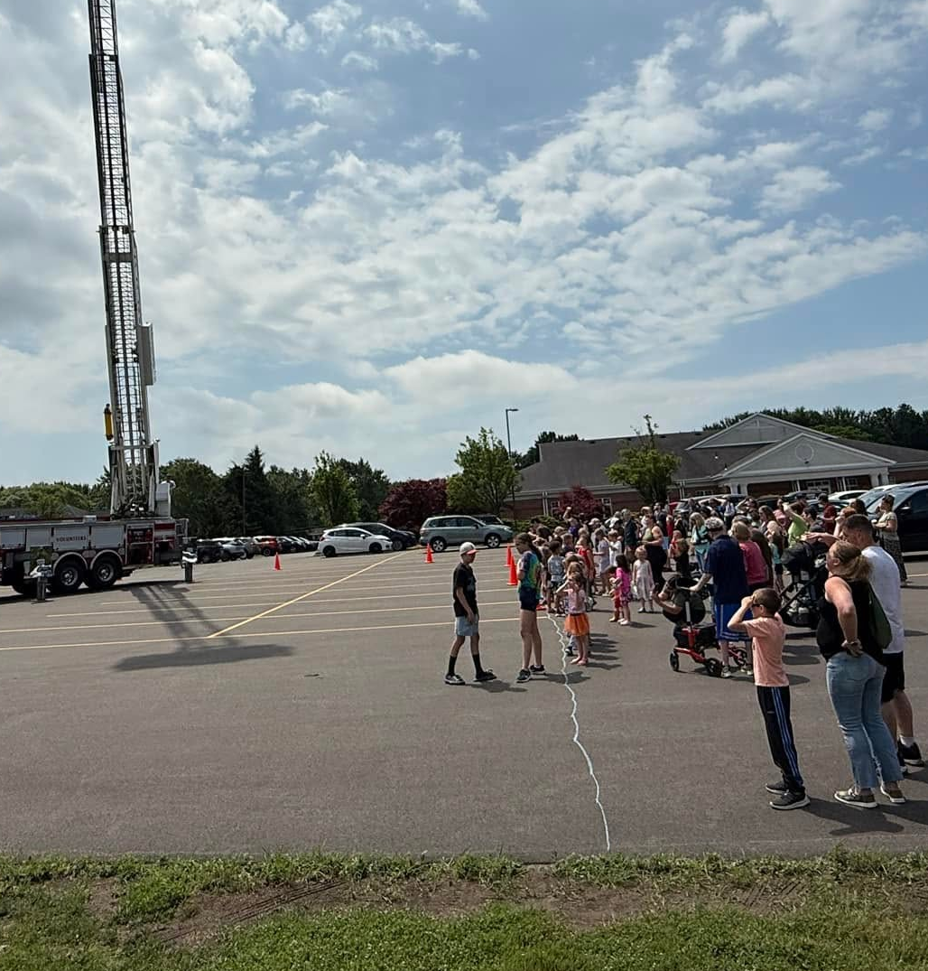
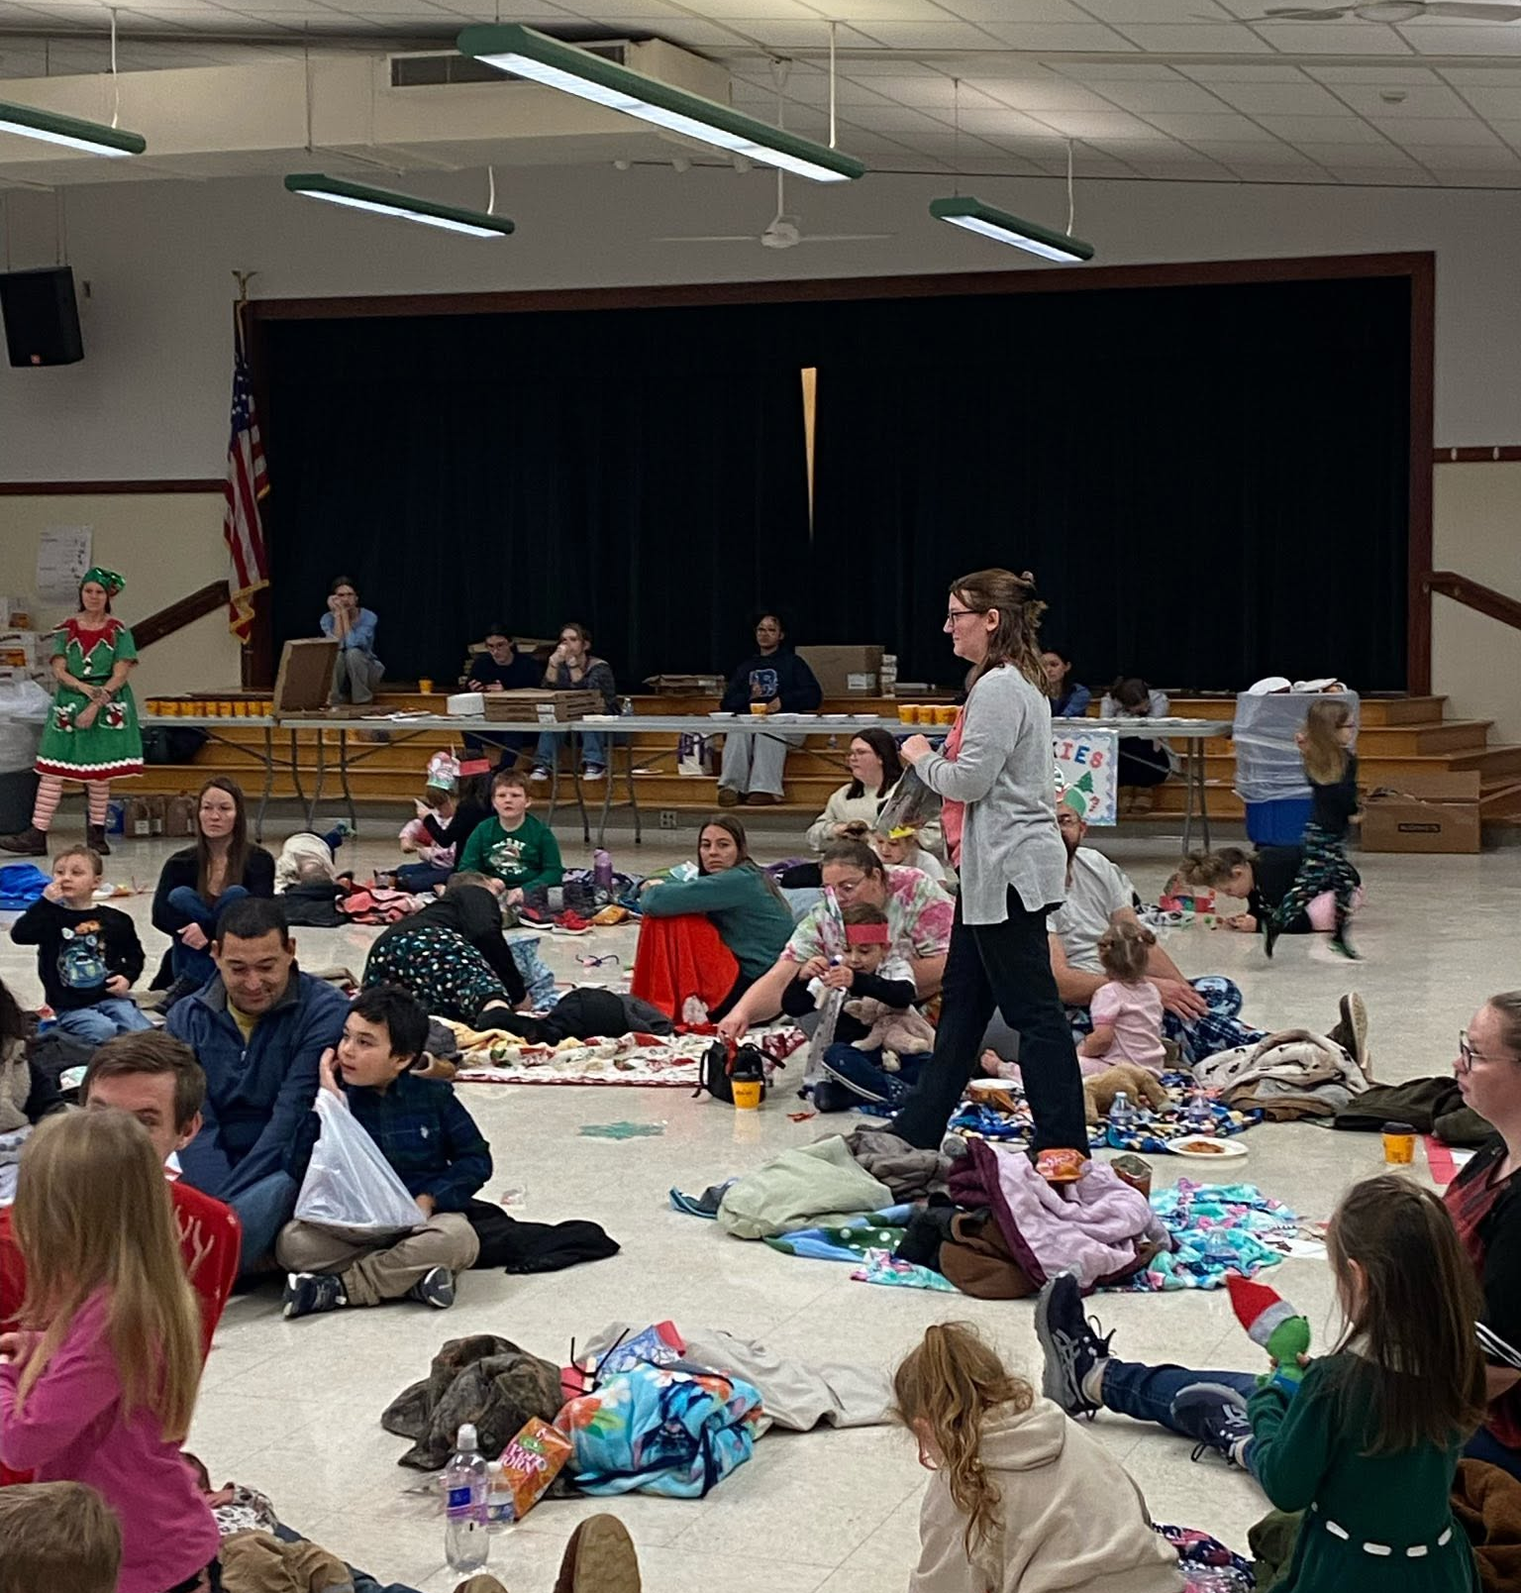
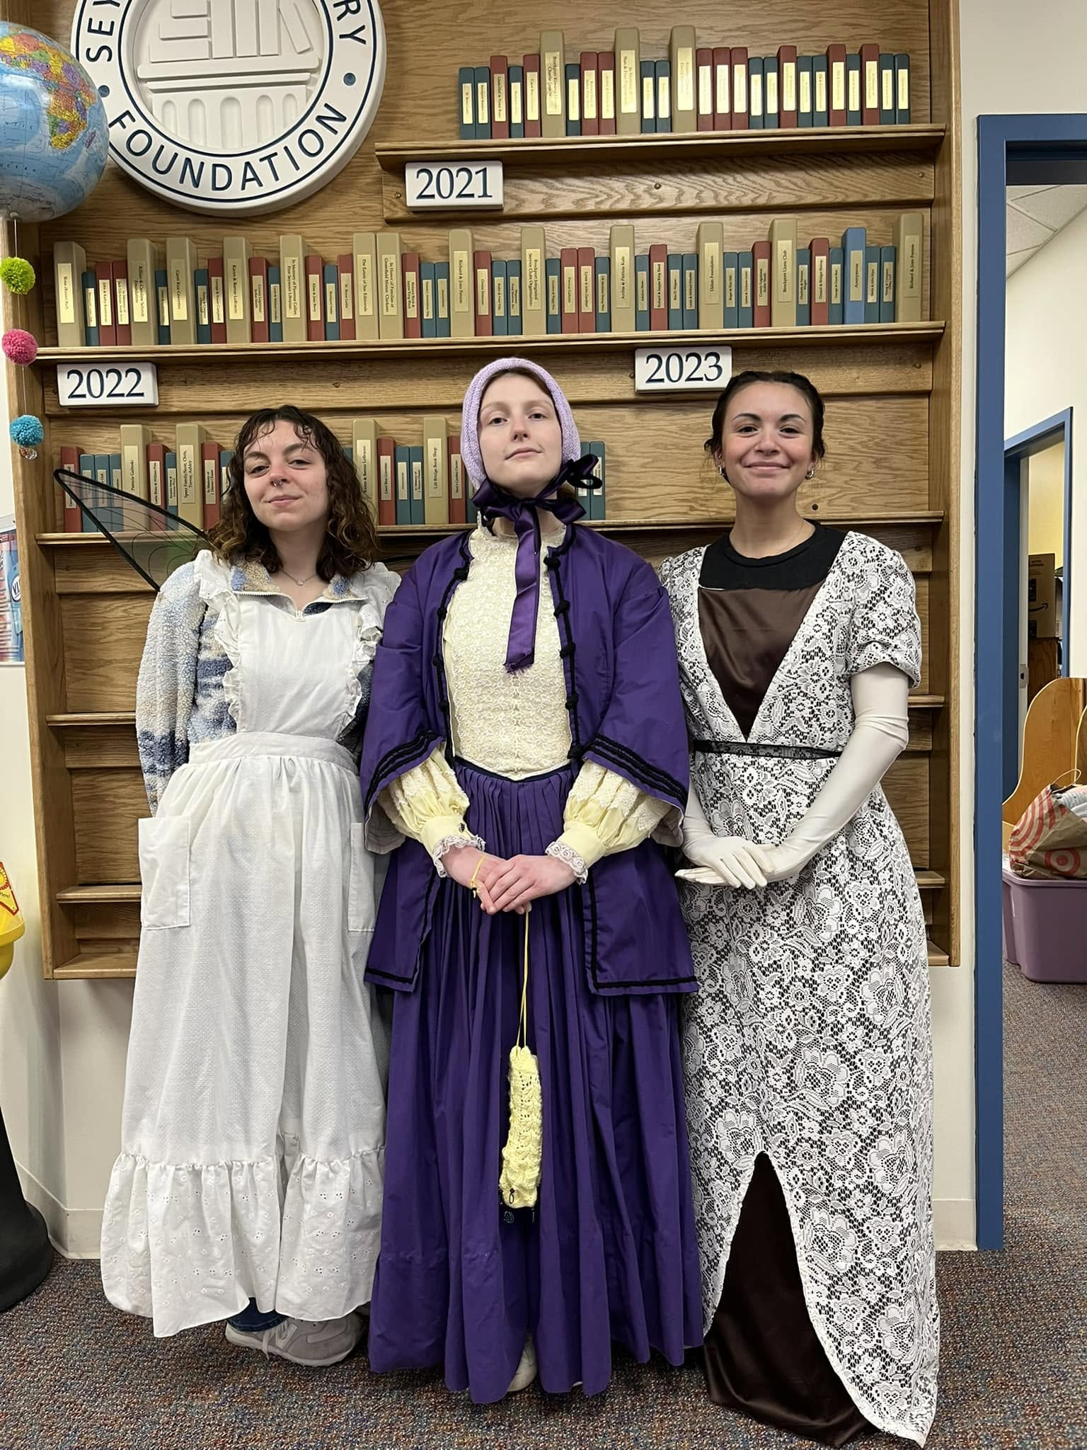
PROGRAMMING GALLERY
Community Gatherings & Outreach
The Library shows up in the community — not just within its own walls.
Summer Egg Drop with Brockport FD
Ginther Holiday Night
Work-Study SUNY Brockport
SEYMOUR LIBRARY | ANNUAL REPORT 2023–2025
17

Slide 18
THE INDEPENDENT AUDIT
FY2025 GASB Financial Statements
Draft audited financial statements, prepared under governmental GAAP — a different lens than the monthly management reports used elsewhere in this report.

Slide 19
INDEPENDENT AUDIT — FY2025
Net Position at a Glance
ASSETS
LIABILITIES
AMOUNT
AMOUNT
Current & Other Assets
$652,664
Long-Term Debt Obligations
$130,728
Capital Assets, net
$635,010
Other Liabilities
$136,836
Total Assets
$1,287,674
Total Liabilities
$267,564
$1,026,061
TOTAL NET POSITION — up $111,069 from the restated beginning balance ($914,992)
$635,010
$53,716
$337,335
Net Investment in Capital Assets
Restricted (donor / other purposes)
Unrestricted
SEYMOUR LIBRARY | ANNUAL REPORT 2023–2025
19

Slide 20
INDEPENDENT AUDIT — FY2025
Why Net Position Jumped: A One-Time Restatement
Net position didn't grow $737,523 in a single year of operations. Most of that is a one-time accounting catch-up, not new wealth.
Net Position, as previously reported
$288,538
What This Means
+ Buildings & equipment now capitalized (net of depreciation)
+$670,303
This is the first year the Library's buildings, equipment, pension liability, and OPEB liability were fully booked under GASB rules — not a sign of new assets or new debt appearing overnight.
The Library's actual FY2025 operating performance is the $111,069 increase after this restatement, not the full jump.
Going forward, net position should move in smaller, more predictable increments year to year.
+ Pension-related deferred outflows/inflows, net
($5,267)
+ Net Pension Liability now recorded
($8,615)
+ OPEB Liability & deferred items, net
($43,226)
+ Working-capital items (receivables, payables, prepaids, cash)
+$20,165
+ Compensated Absences now recorded
($6,906)
= Net Position, beginning (restated)
$914,992
SEYMOUR LIBRARY | ANNUAL REPORT 2023–2025
20

Slide 21
INDEPENDENT AUDIT — FY2025
Fund Balance: What's Really Available to Spend
$515,828
$436,397
$53,716
Combined Fund Balance
Unassigned (Discretionary)
Restricted
General Fund $490,828 + Permanent Fund $25,000
Available for the Board to appropriate without restriction
By donors or the Permanent Fund's terms — not freely spendable
This fund-basis view is a better gauge of near-term spending flexibility than the government-wide Net Position figure — it's the number that most directly answers "what could the Board appropriate today?" Note: in June 2026, subsequent to fiscal year-end, the Board restricted $321,000 of this balance for door replacement and a children’s room renovation, leaving $115,397 unassigned.
SEYMOUR LIBRARY | ANNUAL REPORT 2023–2025
21

Slide 22
INDEPENDENT AUDIT — FY2025
Pension & Retiree Benefits: A Healthy Position
NYS PENSION (ERS)
RETIREE HEALTH BENEFITS (OPEB)
93.1%
$11,296
statewide plan funded ratio — the pension system itself is well-funded
total OPEB liability — modest by any municipal standard
Library's Net Pension Liability
$106,082
Retirees receiving benefits
1
As % of covered payroll
52.6%
Active employees covered
3
2025 required contribution
$25,631
Annual Library cost per retiree
$1,000
Contribution shortfall
$0 — fully paid
Benefit provided
Medical premium only
The Library does not provide ongoing healthcare or life insurance to retirees — unlike many municipalities, it has essentially no legacy retiree-healthcare exposure.
SEYMOUR LIBRARY | ANNUAL REPORT 2023–2025
22

Slide 23
INDEPENDENT AUDIT — FY2025
General Fund: Budget vs. Actual
AMENDED BUDGET
ACTUAL
VARIANCE
Total Revenues
$657,752
$930,561
+$272,809
Total Expenditures
$670,745
$723,436
($52,691)
Excess (Deficiency)
($12,993)
$207,125
+$220,118
FINDING
SUPPORTING DATA
BOARD IMPLICATION
The Library beat its revenue budget by $272,809 but also overspent its expenditure budget by $52,691.
Miscellaneous revenue alone came in $276,641 over budget — almost entirely the O'Toole Estate Bequest ($224, 656). Culture & Recreation spending ran $55,191 over its amended budget.
Per the auditor's note, the overspend was additional program/facility spending funded directly by the large donation received — not a loss of budget discipline on recurring operations.
This is the audited, GAAP-basis confirmation of the same story told earlier in this report: 2025's results were shaped by one extraordinary gift, not a change in day-to-day finances.
SEYMOUR LIBRARY | ANNUAL REPORT 2023–2025
23

Slide 24
INDEPENDENT AUDIT — FY2025
Why These Numbers Don't Exactly Match Earlier Slides
This report uses two legitimate but different sources: the monthly management reports (used in the Financial Overview section) and the year-end independent audit (this section). Both are correct — they answer different questions.
MONTHLY REPORTS
AUDITED GAAP
Basis of accounting
Cash-influenced / QuickBooks
Modified accrual (funds) & full accrual (government-wide)
Capital assets & depreciation
Not tracked as assets
Capitalized & depreciated ($635,010 net)
Pension & OPEB liabilities
Not recorded
Recorded per GASB 68 / 75 ($106,082 / $11,296)
2025 Total Revenue
$925,293
$930,561 (fund basis)
2025 Net Result
$208,885 net income
$207,125 fund excess / $111,069 change in net position
For day-to-day budgeting and cash management, the monthly reports are the right tool. For the Library's overall financial position — assets, long-term obligations, and net worth — the audit is the authoritative source.
SEYMOUR LIBRARY | ANNUAL REPORT 2023–2025
24

Slide 25
2026–2028 LONG RANGE PLAN
What the Data Shows Moving Ahead
The new Plan sets six priorities. Here is what this report's data shows against four informed by track record from the preceding Plan.
Literacy, Birth to Adulthood
Combined (family/multi-audience) programming attendance is up sevenfold — from 470 attendees in 2023 to 3,538 in 2025. Children's programs remain the single largest audience every year.
“Collaborate with educational institutions, organizations and area facilities to support the education of our community, birth through adulthood.” — 2026–2028 LRP
Financial Management
The Library delivered a balanced budget in 2023, 2024, and 2025. The 2027 proposal continues that practice.
“Ensuring best use of municipal funds and maintain a balanced budget.” — 2026–2028 LRP
Workplace Environment
Payroll investment grew from $374,352 to $477,632 over the period. The Library has created internal committees for decision making and improvement.
“Staff satisfaction in the workplace.” — 2026–2028 LRP
Efficient Management of Library Space
Meeting room use is up 158% and study room use is up 68% since 2023 — the clearest signal in this report of where demand is growing.
“Development of a plan of action for infrastructure wants or needs.” — 2026–2028 LRP
Technology Infrastructure and Community Input are also 2026–2028 priorities; this report does not yet track dedicated data against them to date.
SEYMOUR LIBRARY | ANNUAL REPORT 2023–2025
25

Slide 26
COMMUNITY SPACE ROI
The Community's Living Room
Alongside steady growth in circulation, residents are also using the Library's spaces and digital tools more than ever.
↑
+15.7%
+158%
+68%
+167%
Meeting Rooms
Study Rooms
Website Views
Building Visits
289 → 746
609 → 1,025
25,923 → 69,259
65,813 → 76,167
FINDING
SUPPORTING DATA
BOARD IMPLICATION
Space use and digital engagement are growing faster than circulation.
Meeting rooms +158%, study rooms +68%, website views +167%, vs. circulation +15.4%.
Worth monitoring as a secondary trend alongside core lending — may inform future space and staffing planning.
SEYMOUR LIBRARY | ANNUAL REPORT 2023–2025
26

Slide 27
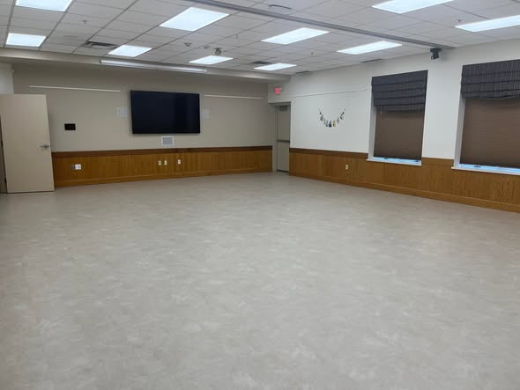
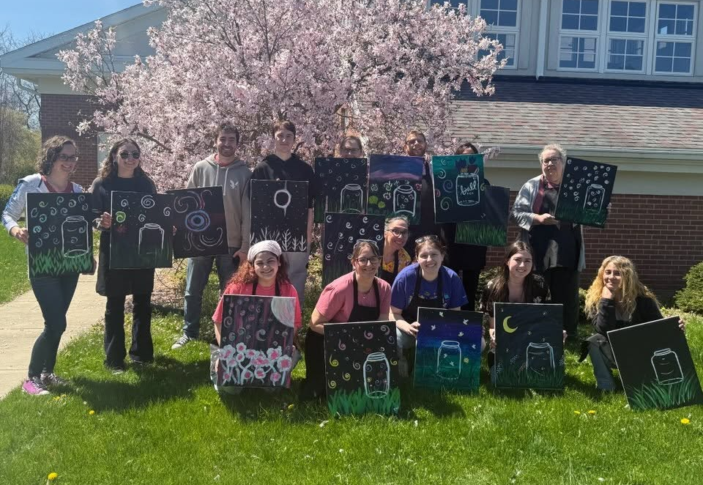
BEHIND THE SCENES
Investing in Our Spaces & Our Team
New flooring and staff development show the Library investing beyond the numbers.
New Meeting Room Flooring
Staff Development Day
SEYMOUR LIBRARY | ANNUAL REPORT 2023–2025
27

Slide 28
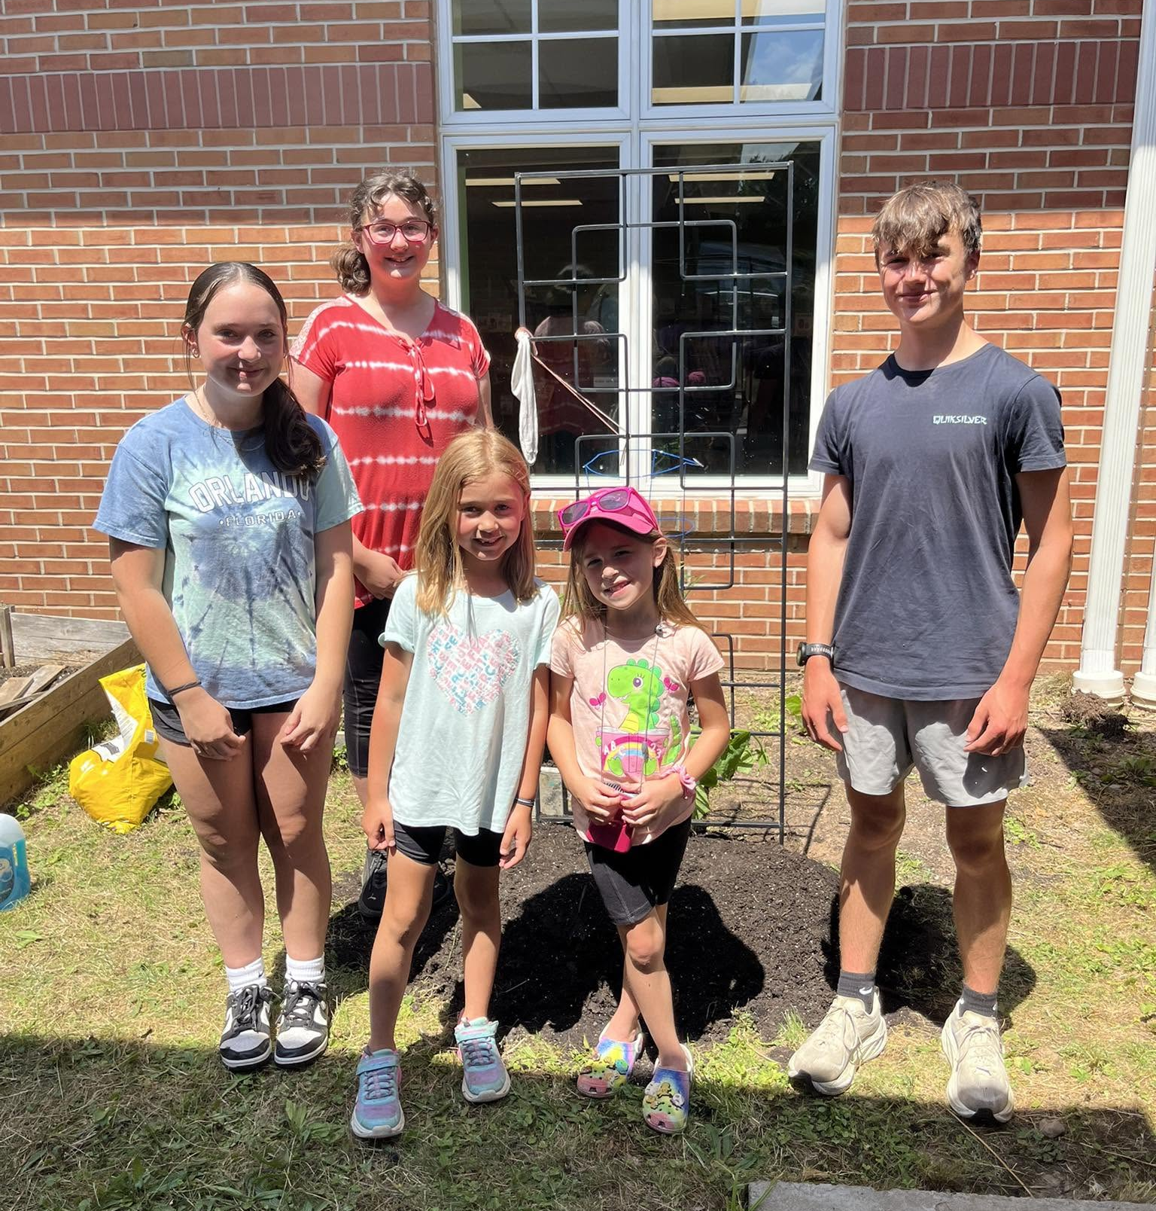
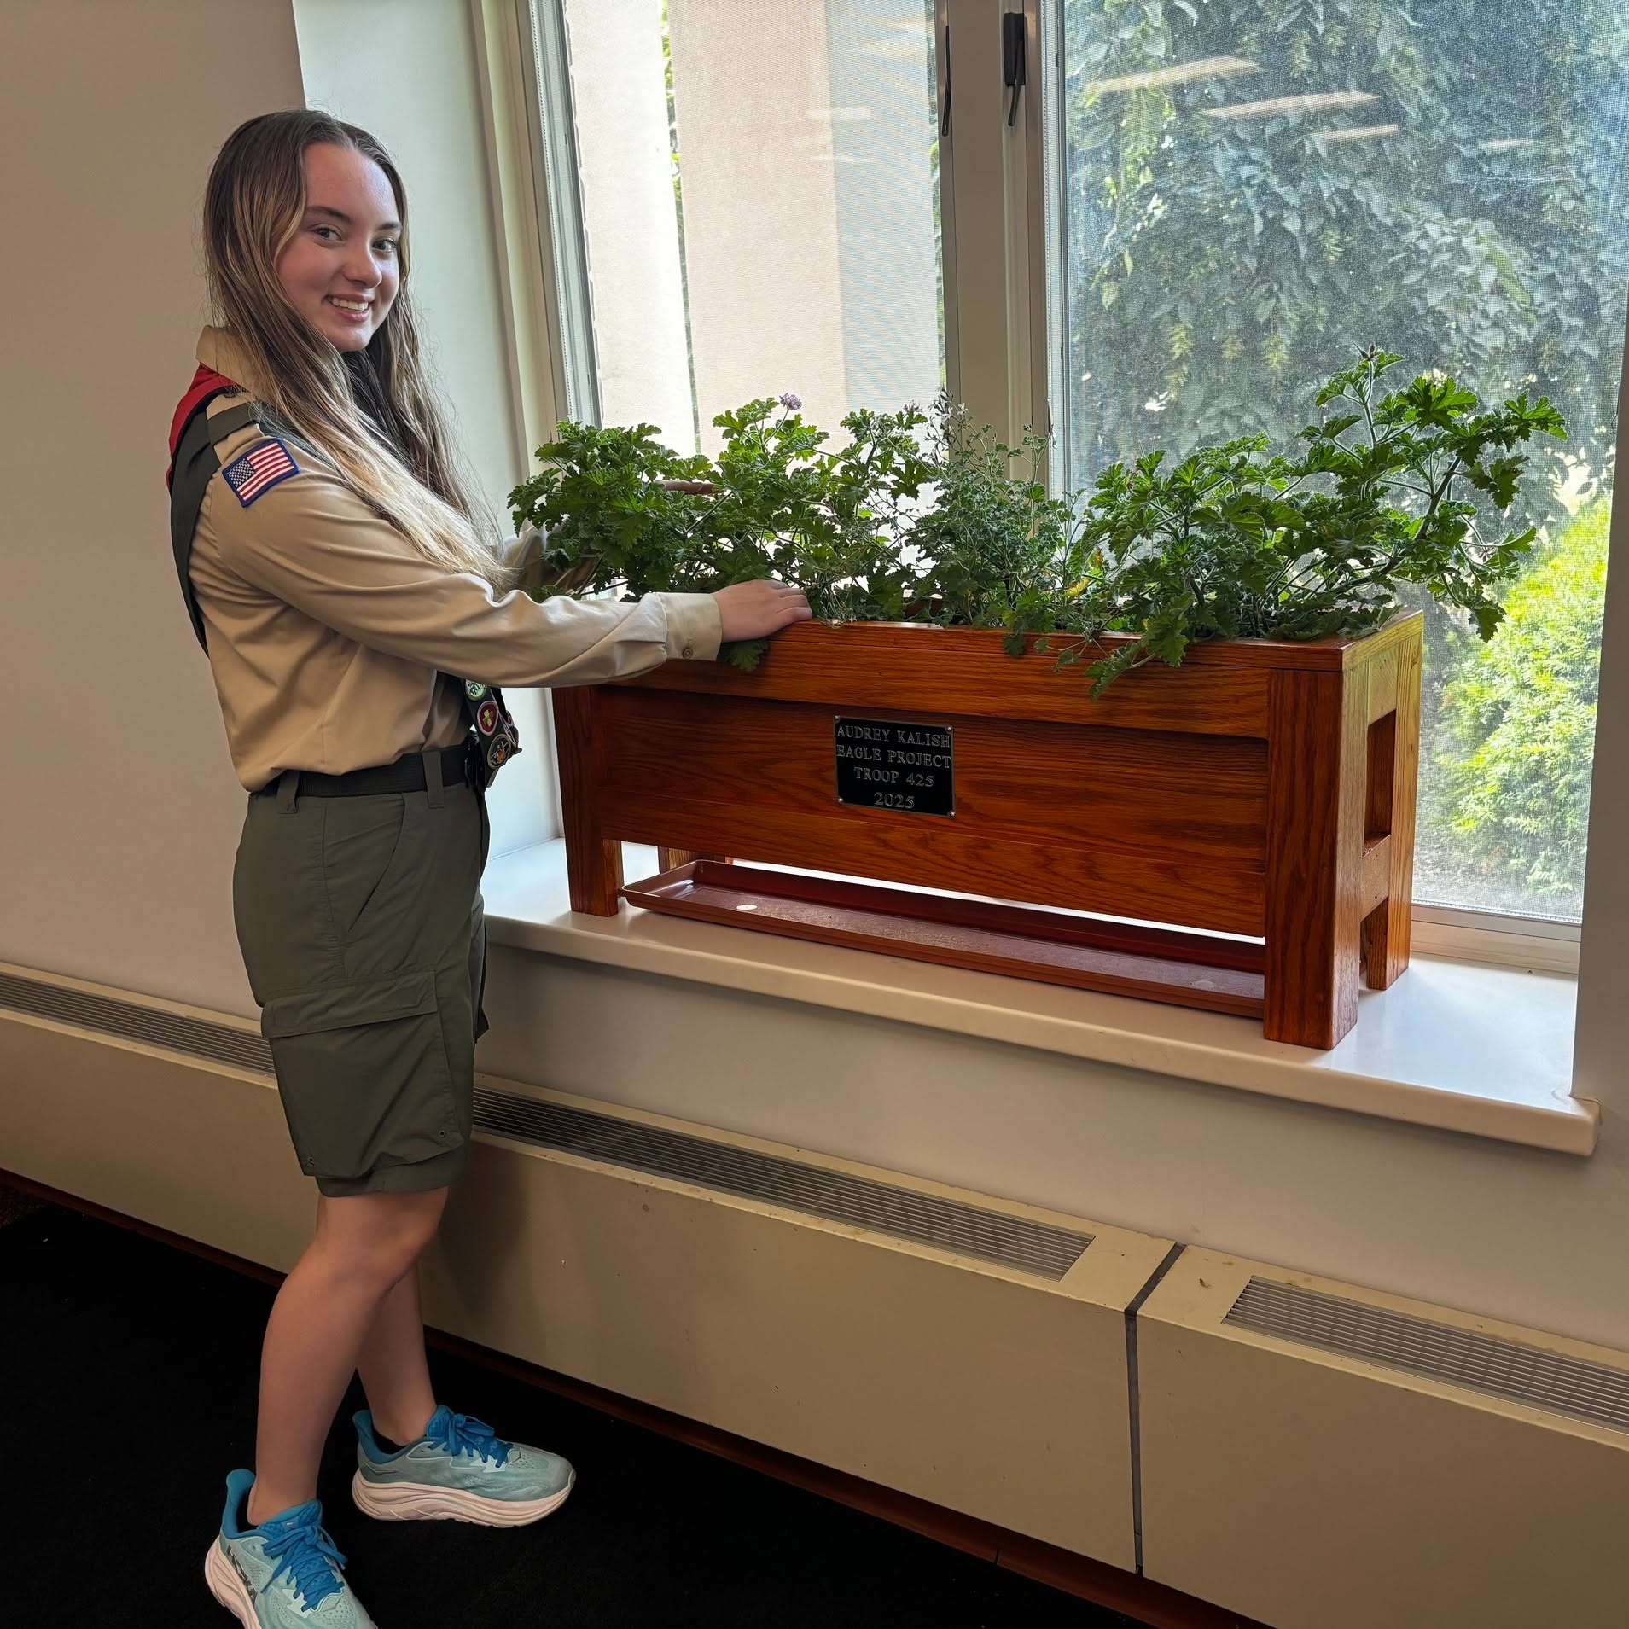
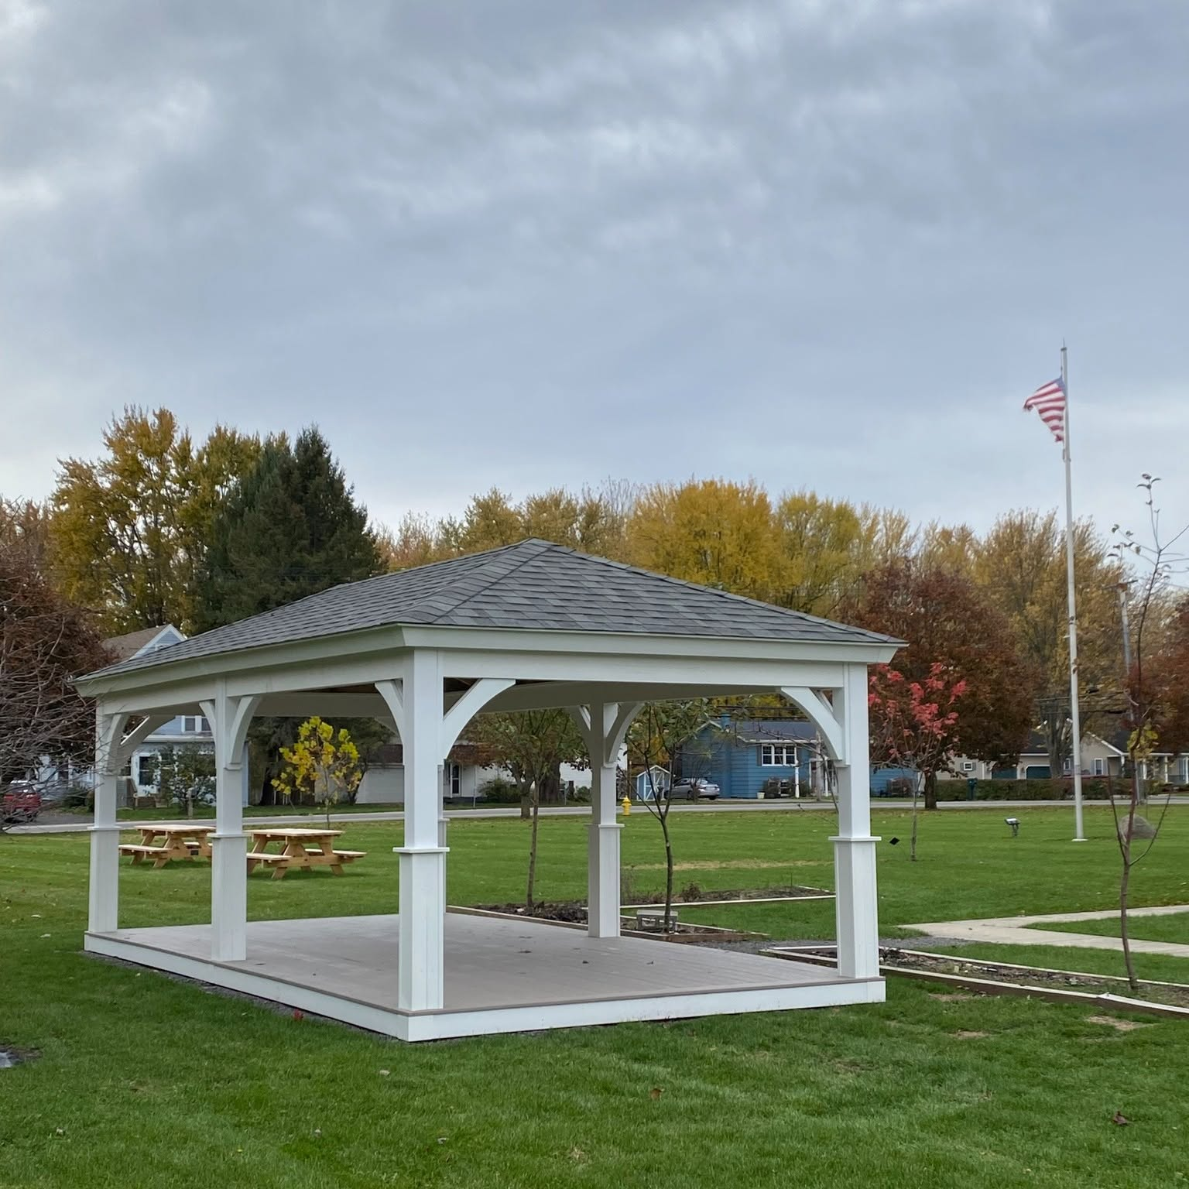
PROGRAMMING GALLERY
Community Partnership & Growing Spaces
Volunteers, civic partners, and new spaces investing in the Library's future.
Teen Volunteers
Eagle Scout Project
New Community Pavilion
SEYMOUR LIBRARY | ANNUAL REPORT 2023–2025
28

Slide 29
LOOKING AHEAD
The 2027 Budget Proposal
A balanced budget built from the Library's actual 2026 mid-year performance.

Slide 30
2027 BUDGET PROPOSAL
2027 Budget at a Glance
Headline
Municipal Support — the direct cost to the towns/village— rises 2.0% in 2027, the same annual increase applied every year in this report.
The 7.8% growth in the total budget comes from drawing the Library’s own reserve for construction and donation purchases — not from additional municipal funding.
2026 Adopted and 2027 Proposed are both balanced budgets, at $711,155 and $766,507.
2026 YTD (through 6/30) is a half-year snapshot, not a run-rate to double — see the next slide for why.
2025 Actual shown here is the audited year-end figure used throughout this report.
SEYMOUR LIBRARY | ANNUAL REPORT 2023–2025
30

Slide 31
2027 BUDGET PROPOSAL
How the June 2026 Numbers Inform 2027
The 2026 YTD (through 6/30/26) column isn't a simple "halfway point" — different revenue and expense lines behave very differently mid-year. Reading it correctly is the key to understanding the 2027 proposal.
Municipal Support
Personnel (Payroll)
Smaller Discretionary Lines
Already 100% known
Tracks almost exactly
Confirm, don't double
Towns invoice their full annual pledge early in the year, so the 6/30 YTD figure ($566,183) already equals the full 2026 Adopted amount. 2027 simply continues the established 2% annual increase.
6-month payroll ($219,584) doubled is $439,168 — within 0.8% of the entire 2027 Proposed payroll line ($442,890). The proposal is essentially built directly from this run-rate.
Fines, misc. income, interest, and donations are running below a simple 50% pace at 6/30 — typical, since some (like interest) post late in the year. 2027 keeps most of these lines flat rather than assuming a full catch-up.
SEYMOUR LIBRARY | ANNUAL REPORT 2023–2025
31

Slide 32

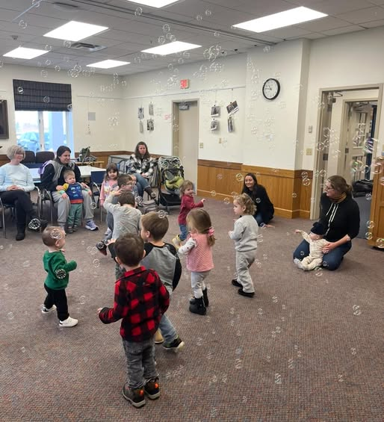
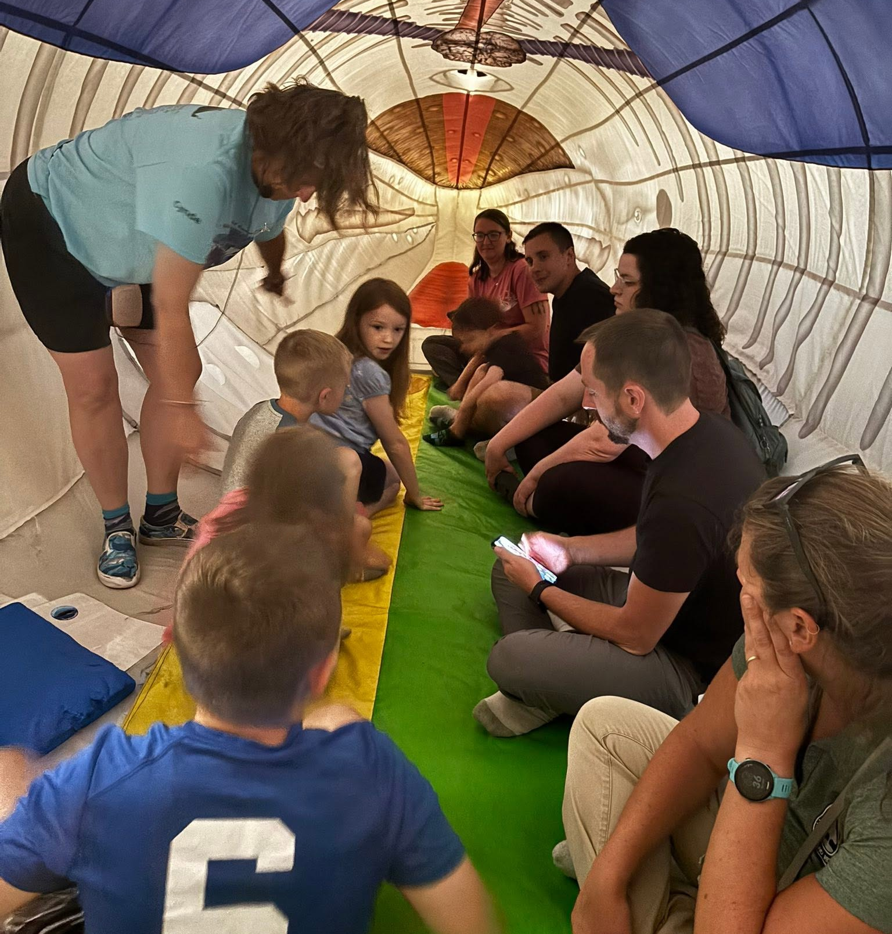
PROGRAMMING GALLERY
Special Visits & Hands-On Learning
From sled dogs to inflatable exhibits, programming keeps expanding.
Sled Dog Visit
Toddler Bubble Time
Traveling Whale Science Exhibit
SEYMOUR LIBRARY | ANNUAL REPORT 2023–2025
32

Slide 33
2027 BUDGET PROPOSAL
What Changes in 2027
REVENUE
EXPENSE
LINE
2026 ADOPTED
2027 PROPOSED
CHANGE
LINE
2026 ADOPTED
2027 PROPOSED
CHANGE
Municipal Support
$566,183
$577,507
+2.0%
Personnel (Payroll)
$428,402
$442,890
+3.4%
Library Revenue (fines, etc.)
$24,500
$24,500
flat
Benefits
$69,883
$74,472
+6.6%
Appropriated Fund Balance
$25,572
$67,000
+162.0%
Library (contractual, insurance)
$192,970
$182,245
-5.6%
Total Revenue
$711,155
$766,507
+7.8%
Total Expense
$711,155
$766,507
+7.8%
SEYMOUR LIBRARY | ANNUAL REPORT 2023–2025
33

Slide 34
2027 BUDGET PROPOSAL
Notable Line-Item Changes
Two line items outside the routine drive most of what changes in the 2027 proposal.
FINDING
SUPPORTING DATA
BOARD IMPLICATION
Property insurance is budgeted to fall 50%, from $24,000 to $12,000, after the Library switched insurers in 2026 — the main driver of the Library category's decline.
The new policy actually costs $9,974 ($9,949 premium plus $25 for an additional insured); the $12,000 budgeted builds in room for expected premium increases with the new carrier.
This is a confirmed policy change already in effect, not an estimate — the Library carries this policy with the Stewart Insurance Agency through Erie Insurance.
The $67,000 Fund Balance draw now properly budgets $30,000 for construction — the first draw against the Board’s $321,000 reserve for door replacement and the children’s room renovation, restricted in June 2026 — and $15,000 for donations, costs the FY2025 audit found were previously unapproved. The rest, $22,000, is carried-over interest.
SEYMOUR LIBRARY | ANNUAL REPORT 2023–2025
34

Slide 35
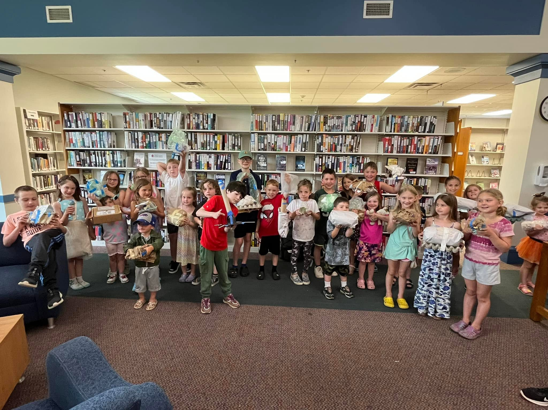
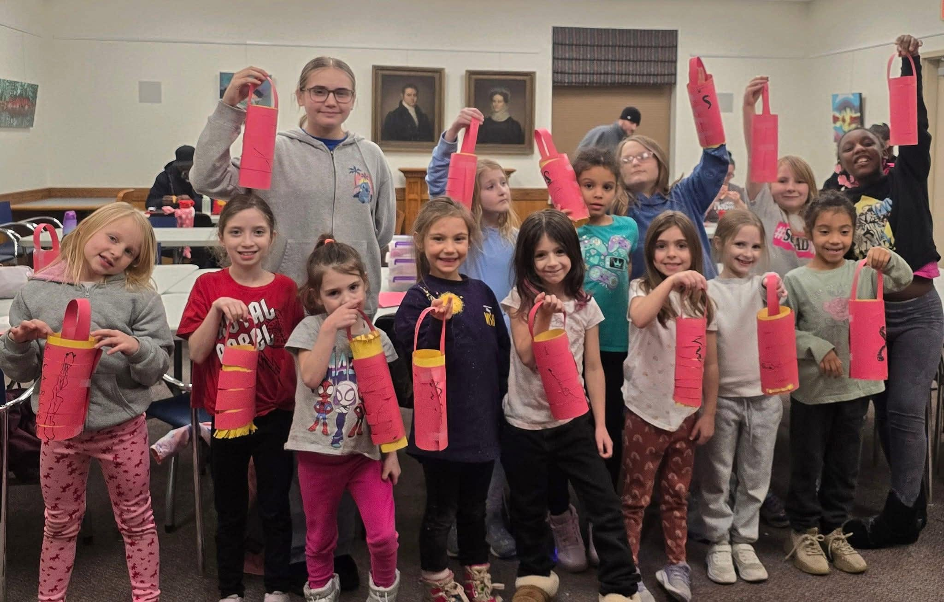
PROGRAMMING GALLERY
Creative Programming in Action
Hands-on projects turn everyday materials and traditions into learning.
Recycled Materials Challenge
Lantern Cultural Program
SEYMOUR LIBRARY | ANNUAL REPORT 2023–2025
35

Slide 36
WHY IT WORKS
A 2027 Budget Grounded in 2026 Reality
✓
Balanced by design: revenue and expense are proposed equal at $766,507, continuing the Library's balanced-budget practice.
✓
Personnel — the largest expense line — is built directly from the actual 2026 mid-year run-rate, not a guess: +3.4% over 2026 Adopted.
✓
Municipal support, the largest and steadiest revenue source, continues its established, predictable 2% annual increase.
The Appropriated Fund Balance draw grows to $67,000, but now properly budgets $30,000 for construction — from the Board’s $321,000 reserve for door replacement and the children’s room renovation — and $15,000 for donation purchases — costs the FY2025 audit found had gone unbudgeted, causing a $52,000 overrun that year.
✓
✓
Smaller, less predictable revenue lines are held flat rather than assuming an optimistic full-year catch-up from a soft first half.

Slide 37
2027 BUDGET PROPOSAL
Looking Further Ahead: Unknowns Not Yet in This Budget
The 2027 Proposed Budget reflects what's known today. These items are real possibilities on the horizon — not yet quantified and not built into any figure in this report.
ANTICIPATED EXPENSES
ANTICIPATED REVENUE
MCLS Integrated Library System Upgrade
Grants — State, Local & Federal
Monroe County Library System periodically upgrades the shared catalog platform; member libraries typically share the cost.
Funding may come through NY State, MCLS, or federal library grants — amounts and timing depend on future award cycles.
Potential End of the E-Rate Program
This federal program subsidizes library internet and telecom costs; cuts would shift those costs onto the Library's budget.
Future Bequests
The O'Toole Bequest shows a real track record of estate gifts — future bequests are unpredictable but a genuine possibility.
Future Capital Projects
The 2023–2024 work addressed near-term needs — the building will need further investment (e.g. library spaces, HVAC) ahead.
None of these are built into the 2027 Proposed Budget — they cut in both directions and are worth factoring into multi-year reserve and capital planning.
SEYMOUR LIBRARY | ANNUAL REPORT 2023–2025
37

Slide 38
PREPARED FOR THE BOARD
Five Findings for Board Review
Building usage has become the most significant growth indicator.
1
Circulation continues to grow despite changes in customer behavior.
2
Personnel investments directly support community outcomes.
3
2024 deficits were driven by strategic infrastructure projects.
4
2025 surplus was driven by the O'Toole Estate Bequest.
5

Slide 39
FOR BOARD CONSIDERATION
Suggested Next Steps
1
Continue investment in public-facing spaces.
2
Monitor operating margins excluding one-time gifts.
3
Build reserves using extraordinary gift revenue.
4
Continue growth in combined programming and expand standalone adult programming.
5
Continue tracking room-use metrics as a secondary indicator alongside circulation and programming.
SEYMOUR LIBRARY | ANNUAL REPORT 2023–2025
39

Slide 40
APPENDIX
Supporting Data Tables
Full revenue, expense, and performance-metric detail for trustee reference.

Slide 41
APPENDIX
Full Revenue Table, 2023–2025
SOURCE
2023
2024
2025
Municipal Support
$533,528
$485,792
$553,163
Donations & Bequests
$15,164
$18,853
$284,925
Friends of the Library
$10,831
$15,276
$17,976
Grants
$10,848
$18,269
$28,011
Other
$25,203
$55,748
$41,218
Total Revenue
$595,574
$593,937
$925,293
Source: audited monthly financial reports, FY2023–FY2025. "Grants" = FFRPL Tummonds Fund Grant + Library System Grant. "Other" = fines, membership, misc. income, interest & earnings, and (2023–24) Kiwanis Book Mark Contest.
SEYMOUR LIBRARY | ANNUAL REPORT 2023–2025
41

Slide 42
APPENDIX
Full Expense Table, 2023–2025
CATEGORY
2023
2024
2025
Payroll & Benefits
$374,352
$418,746
$477,632
Contractual Operations
$153,387
$131,406
$127,910
Capital Projects
$82,100
$234,734
$6,383
Other
$62,917
$81,580
$104,483
Total Expenses
$672,756
$866,466
$716,408
SEYMOUR LIBRARY | ANNUAL REPORT 2023–2025
42

Slide 43
APPENDIX
Key Performance Metrics, 2023–2025
METRIC
2023
2024
2025
Building Visits
65,813
72,546
76,167
Total Circulation
153,970
170,840
177,656
Meeting Room Usage
289
464
746
Study Room Usage
609
772
1,025
Reference Transactions
16,473
14,451
16,530
Website Views
25,923
45,799
69,259
Adult Program Attendance
4,082
2,096
978
Children's Program Attendance
7,766
5,800
6,907
Teen Program Attendance
729
560
573
Combined Program Attendance
470
1,838
3,538
SEYMOUR LIBRARY | ANNUAL REPORT 2023–2025
43

Slide 44
S
Thank You
Seymour Library · Board of Trustees Report 2023–2025

